Slide 1
Success Stories: Water Conservation Examples in Industry
Steven Lewis, Jr.
ON Semiconductor, Manager, Global Facilities

Slide 2
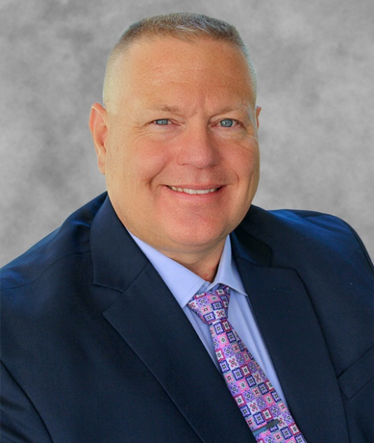
Steven Lewis, Jr., Global Facilities
Professional Profile
Steven has been with ON Semiconductor / Motorola since 1997. He leads a multinational, highly diverse team of professional facilities engineers worldwide. He is directly responsible for capital planning for all ON Semiconductor global facilities infrastructure and other supporting activities for 24 individual factories and numerous other office and laboratory locations.
He leads the Global Facilities Engineering team that is responsible for assisting sites with their construction activities as well as providing direction on standards and managing risks at the individual sites. They support risk management services and provide expertise for troubleshooting highly technical problems. They also provide mentorship to the various manufacturing locations engineering teams to advance their technical knowledge. The Global Facilities Engineering team also is responsible for establishing and implementing standard procedures and programs, such as the implementation of Oracle’s Enterprise Asset Management (eAM) for managing preventative and predictive maintenance on facilities equipment.
Steven develops his teams by using collaborative techniques that take advantage of the strengths of the various team members. Through using these strengths, his teams are developing into world class facilities operations, with a strong focus on customer support. This leadership also is used in looking for sustainable alternatives to normal facilities practices that are both good for the environment and for the bottom line.
Steven has participated with Arizona State University’s Del E. Webb School of Construction’s Industry Advisory Board and Cleanroom construction class. Steven taught and evaluated classes in ASU’s Facilities Manager Development Program and Project Manager Development program, with particular focus on contractor management.
Steven has a Master’s of Business Administration and a Bachelor of Science degree in Engineering Science with a Specialty in Nuclear Sciences from Arizona State University. He also has a Master’s of Arts degree in Wildlife Biology from Miami University of Ohio. He has a certified Facilities Management Professional (FMP) certificate from the International Facilities Management Association.
In addition to these professional pursuits, Steven is a wildlife/nature photographer with many accomplishments. He volunteers time at Usery Mountain Park in the Phoenix, AZ area teaching photography and leading natural history photography hikes. He also volunteers and is a donor at the Phoenix Zoo.
Notes:
Number of Incidents: This is the number of reported incidents over the last 12 months, separated by whether they are criminal or not.
Value of Company Losses: This is the value of losses from theft or damage that the company has incurred in the last 12 months.
Cycle Time: Every incident is reviewed for root cause and corrective items that could prevent a recurrence. This chart shows the number of days from initial report to closure of associated action items.
Site Distribution: This shows where the incidents that have been reported over the last 12 months have been occurring.
Incident Type Breakdown: This shows the types of incidents that have been reported over the last 12 months.

Slide 3
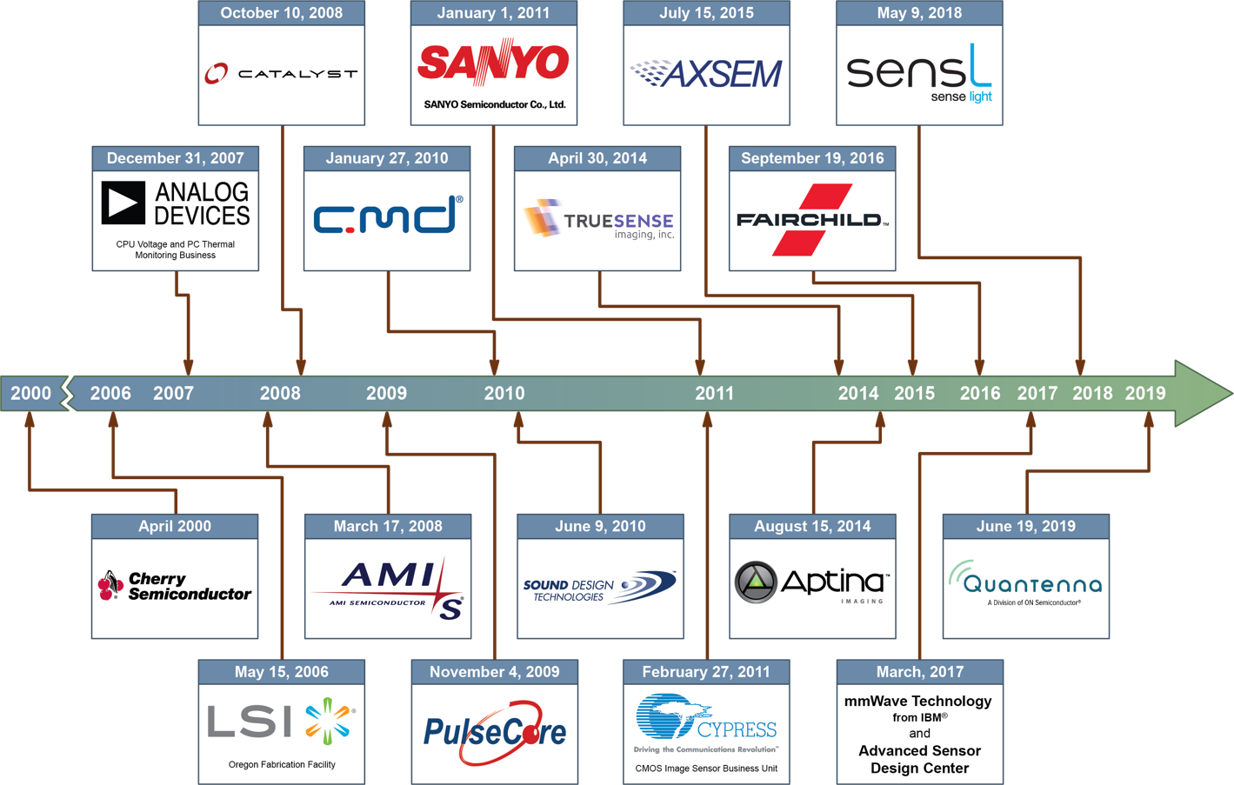
The Legacy Builds!
Notes:
In 1999, ON Semiconductor separated from Motorola and became a public company in 2000. Since our inception we have grown significantly through organic growth, along with mergers and acquisitions.
2000: Cherry Semiconductor - New Products: Multi-phase Controllers, Drivers, Automotive/Industrial Power Management, Automotive ASSPs.
2006: LSI Logic Design & Manufacturing Facility - Focus: Process Technology & Packaging.
2007: ADI Voltage Regulation & Thermal Management Group - New Products: Multi-phase Controllers, Drivers, Thermal Management Devices.
2008: AMI Semiconductor - New Products: HV ASICs for Automotive Applications, ULP SRAM Memory, LIN & CAN Transceivers, Low Power RF Transceivers, Stepper Motor Drivers, Audio DSP Systems, Power-over- Ethernet, Industrial Process Automation. Existing Product Enhancements: Clocks & Timers, High Side Drivers.
2008: Catalyst Semiconductor - New Products: Digital Potentiometers, I/O Expanders, EEPROM/NVRAM. Existing Product Enhancements: LED Drivers, DC-DC Converters, LDO & Linear Regulators, Voltage Supervisors, Temperature Sensors.
2009: PulseCore Semiconductor - New Products: Spread- Spectrum Clocks.
2010: California Micro Devices - Existing Product Enhancements: ESD Protection, EMI Filters, Interfaces, Power Management.
2010: Sound Design Technologies - Existing Product Enhancements: ULP DSP, High Density Interconnect Technologies.
2011: SANYO Semiconductor - New Products: Microcontrollers, Motor Drivers, Audio/Video, Power Modules. Existing Product Enhancements: Power Management, ASICs, Memory, MOSFETs, IGBTs.
2011: Cypress Image Sensor Business Unit - New Products: 2D High-Performance CMOS Image Sensors.
2014: Truesense Imaging - New Products: CCD Image Sensors.
2014: Aptina Imaging - New Products: CMOS Image Sensors, Image Processors.
2015: AXSEM - New Products: RF Transceivers.
2016: Fairchild Semiconductor - New Products: MEMs Motion Sensors, Optoelectronics, High Voltage MOSFETs. Existing Product Enhancements: Power Management, Power Modules, Signal Conditioning, Logic, Discretes. The combination of ON Semiconductor’s and Fairchild’s AC to DC, DC to DC and power discrete portfolios creates an industry leader in high performance power conversion serving a broad range of applications traversing the high, medium and low voltage spectrum. Fairchild’s super-junction MOSFETs and ON Semiconductor’s GaN power switches enable significantly improved power density and efficiency for industrial variable speed drives, as well as uninterruptable power supplies used in networking, telecom and data center applications. In addition, Fairchild has an established footprint in cloud power solutions that includes networking equipment and data center servers.
2018: SensL - imaging, radar, LiDAR
2019 Quantenna – allowing more WiFi capabilities

Slide 4
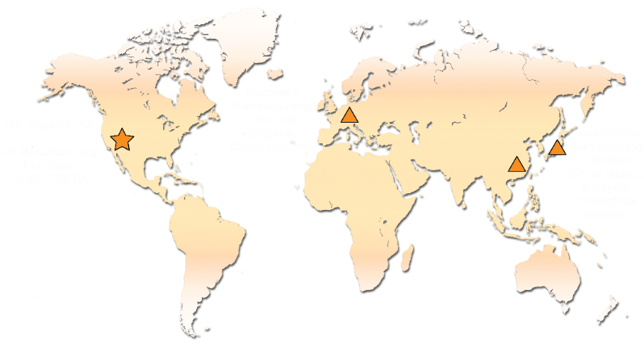
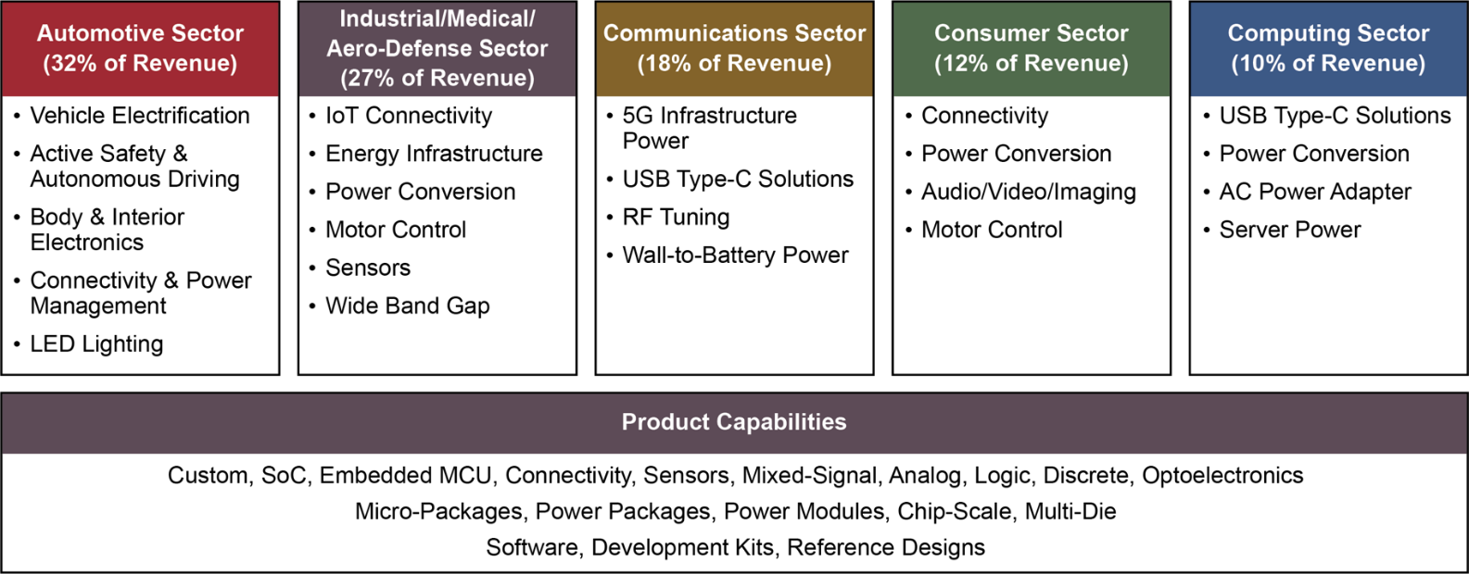
ON Semiconductor Today
HQ: Phoenix, AZ
US Manufacturing Facilities
ID, ME, OR, PA
European Manufacturing Facilities:
Belgium, Czech Republic
Headquarters: Phoenix, AZ
Employees: 32,000 globally
Revenue: ~$5.9Bn⁽¹⁾
Ticker: ON
Founded: Spun-off from Motorola 1999, IPO 2000
Asia/ Manufacturing Facilities:
China, Japan, Malaysia, Philippines, Vietnam
(1) Based upon 2018 results; Sector % based on 2Q19

Slide 5
ON Semiconductor
    Expansive Product Portfolio and End-Market Presence
    Global Manufacturing and Supply Chain Footprint
    Industry Leading Cost Structure
    Applications Expertise
Scale
Favorable
End-markets
Broad Product & Technology Portfolio
Automotive
Industrial
Cloud Power
High Performance Analog and Mixed-Signal
Sensors
Power Solutions
Formidable Scale with ~$5.9B in revenue¹
>1.5B Units/Week²
Wide Sales Reach
IoT
(1) Based upon 2018 results; (2) based on 2018

Slide 6

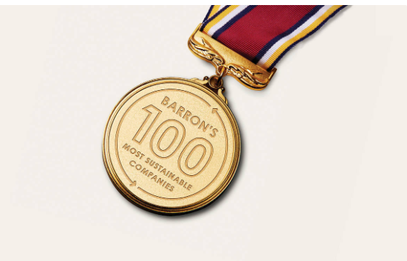




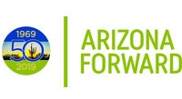


Awards and Recognition
2019 Barron’s 100 Most Sustainable Companies
ON Semiconductor has been ranked a second year in a row on the list of 100 Most Sustainable Companies in the U.S. The company was scored on 5 key areas: shareholders, employees, customers, community and planet.
World’s Most Ethical Companies®
ON Semiconductor has been named among the world’s most ethical companies for four consecutive years by Ethisphere Institute. ON Semiconductor is one of only three honorees in semiconductor industry category in 2019.
2019 North America Dow Jones Sustainability Index
ON Semiconductor has been included in the North America Dow Jones Sustainability Index for a second year as one of four semiconductor companies in 2019.
Responsible Business Alliance
Fourteen (14) ON Semiconductor manufacturing sites were recognized by the Responsible Business Alliance (RBA) for outstanding audits in 2018 and 2019. Of the 14 sites, eleven (11) earned the full 200 points in the RBA Validated Audit Process (VAP) audits.
Arizona Forward Award
ON Semiconductor was awarded the Award of Distinction by Arizona Forward, an organization devoted to sustainability progress for Arizona, for their outstanding contributions towards sustainability.
Top Sustainable Company in Arizona
In 2019, Shorr Packaging identified which companies across the United States are leading the pack relative to best in-class, sustainable supply chains and

Slide 7
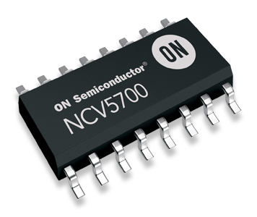
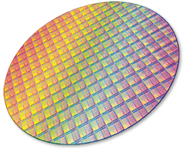
Factory Types and Main Water Uses
Wafer Fabrication Facilities
HVAC
RO/DI Production
Pollution Control
Process Cooling
Assembly/Test Facilities
HVAC
RO/DI Production
Process Cooling
Pollution Control

Slide 8
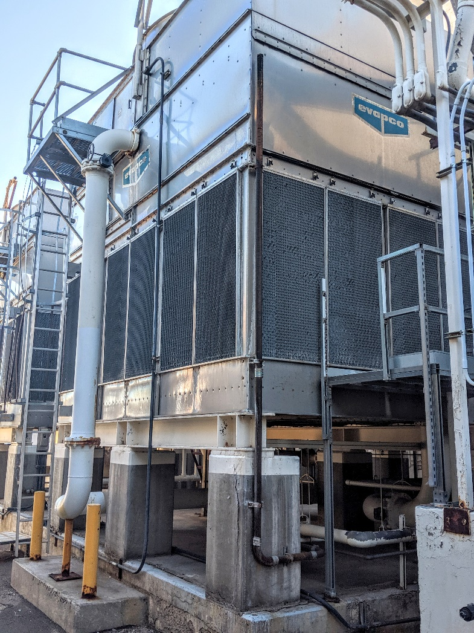
HVAC Successes
RO Reject
  Cooling Tower Make-up
Maximizing Cycles
  Ensuring cooling towers are operating efficiently
  Proper water treatment
Pre-Cooled Well Water to Cooling Towers
Air Cooled Chillers
  Pluses and Minuses

Slide 9
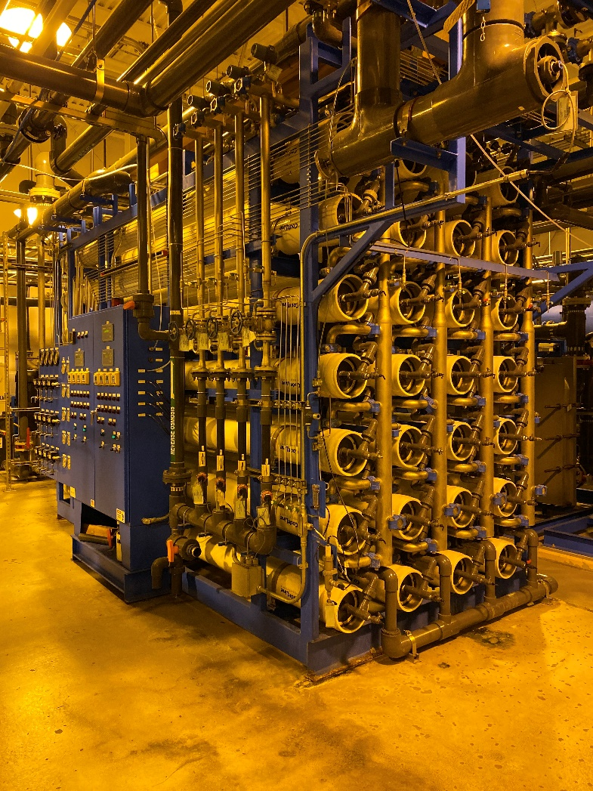
Process Successes
Process Optimization/Idle Flow
  Ensured the process is optimized
  Older equipment needed retrofit to idle water flow when not in use
Capture Clean Rinse
  Separated concentrated and rinse drains to allow for reuse
2nd Pass RO and Brine Recovery
  Not all factories using 2nd Pass
  Brine recovery reduces demand
EDI
  Less water needed because of reduced regeneration

Slide 10
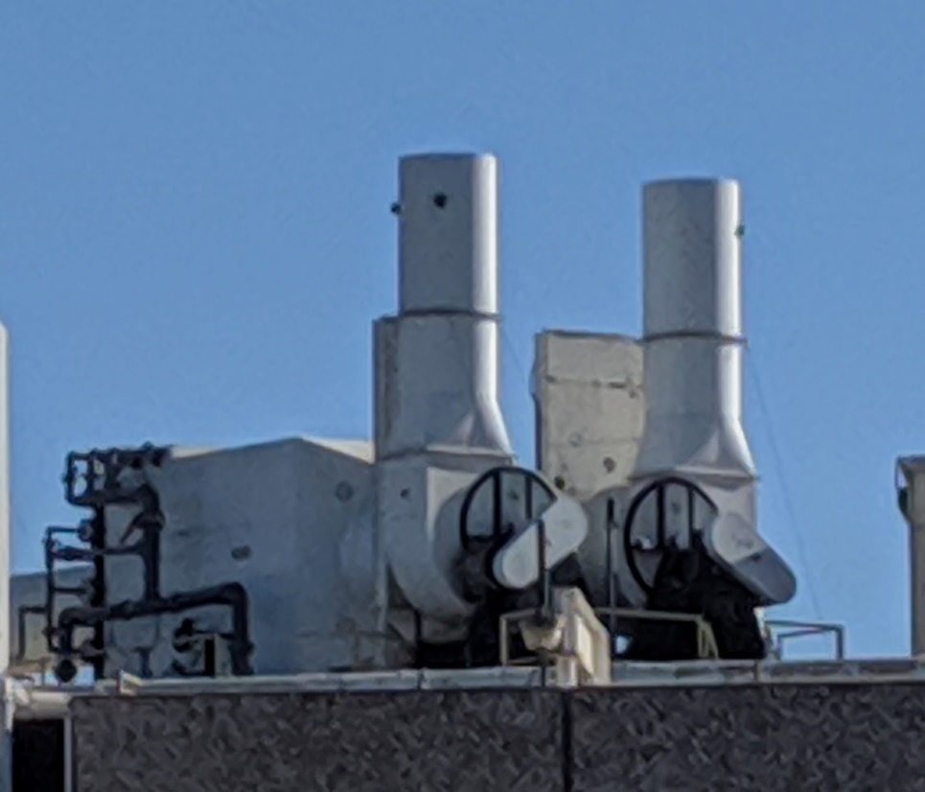
Pollution Control Successes
Recycling
  Clean Rinse
  Continuous Ultrafiltration
  Challenges of where to use
    Pollution prevention
    Reprocessing
Water Recirculation in Point of Use Abatement
  Add cycles instead of pass through
Gray Water Usage
  Restrooms
  Landscaping

Slide 11
Annual Water Usage, Recycling, and Cost

Slide 12
Water Conservation Savings ($K)

Slide 13
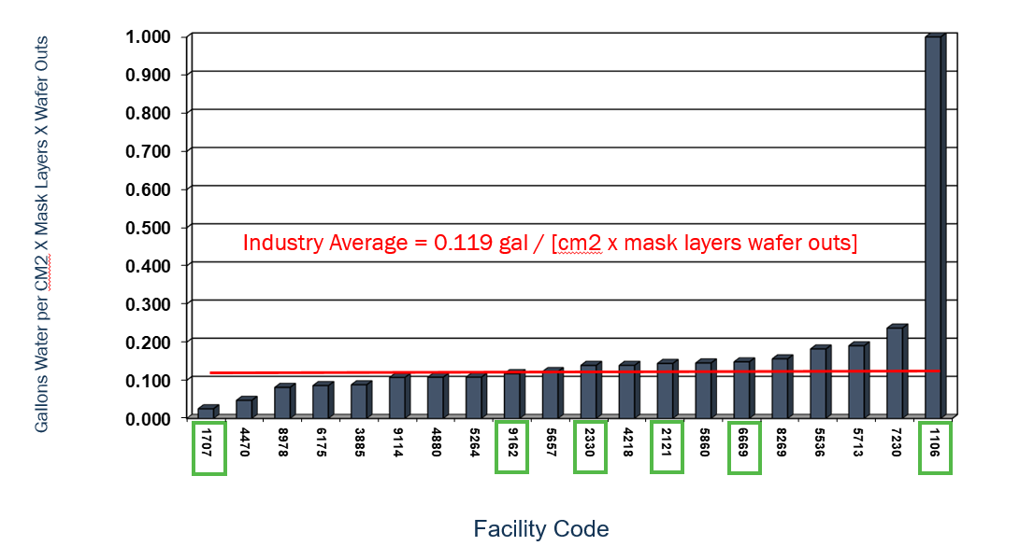
Normalized Water Usage [cm2 x Mask Layers x Wafer Outs] – ON Semiconductor USA Wafer Fab Facilities

Slide 14
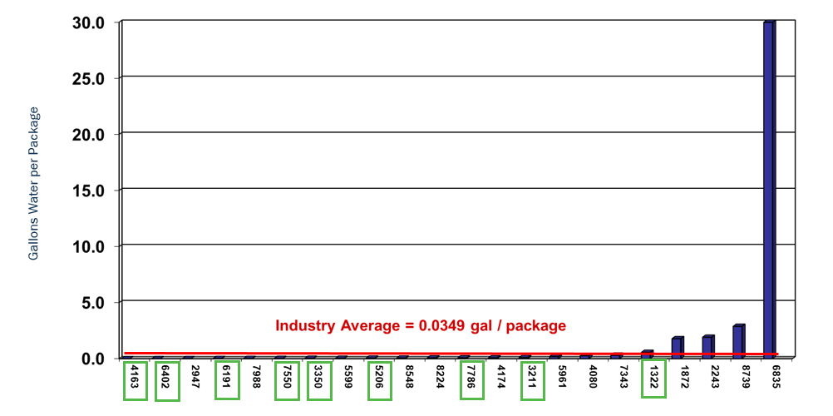
Normalized Water Usage [Number of Packages] Backend Facilities ON Semiconductor Operations in Asia & Canada
Facility Code

